Slide 1


Kerala Spaceparks (kSpace)
Opportunities for national and global investors
SIA INDIA Virtual Conference on
‘Satellite Ground Segment in India- Way Forward’
G Levin
Project Director
Kerala Spaceparks (kSpace)
17th December ,2021

Slide 2

VISION “ Make Aero(Space) industry play a significant role in the growth of Kerala”
Mission “ Make Kerala a major world Aero(Space) production and services hub”
Immediate mission “ Establish a Centre of Excellence in Aero(Space) products and services at Thiruvananthapuram”

Slide 4
kSpace invites investments in all the four domains

Slide 5

Space technology
revolution lead by private entrepreneurs

Slide 6
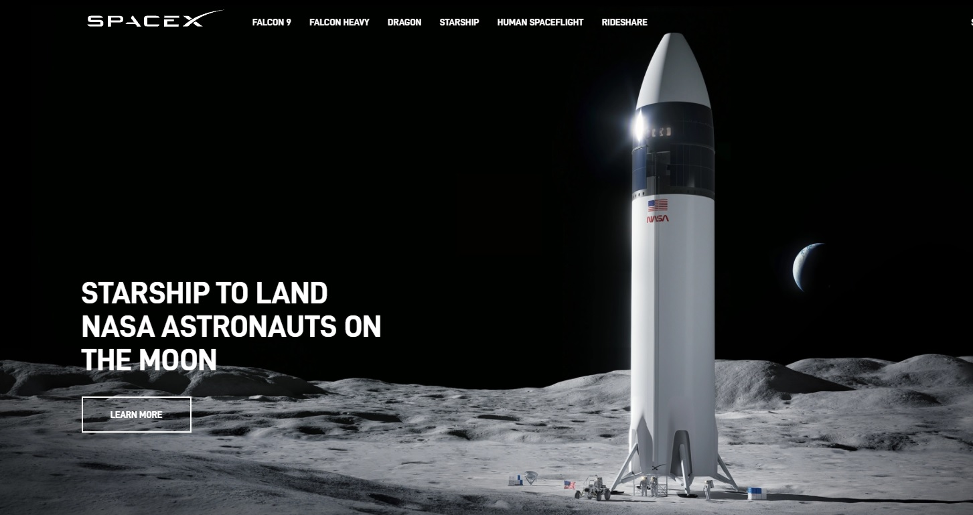
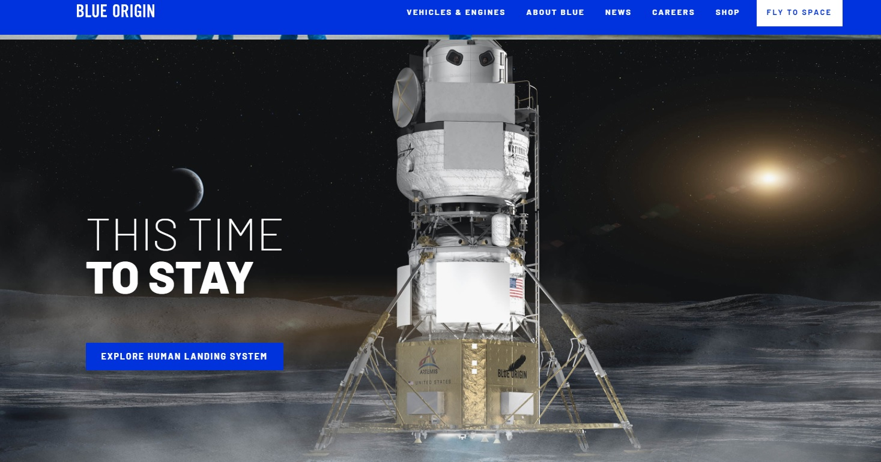
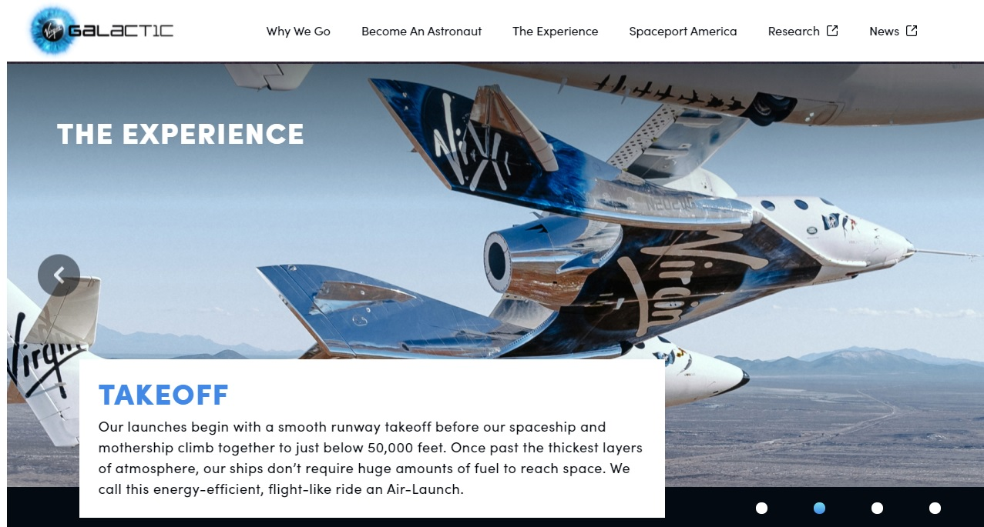
SpaceX
Blue Origin
Virgin Galactic

Slide 7
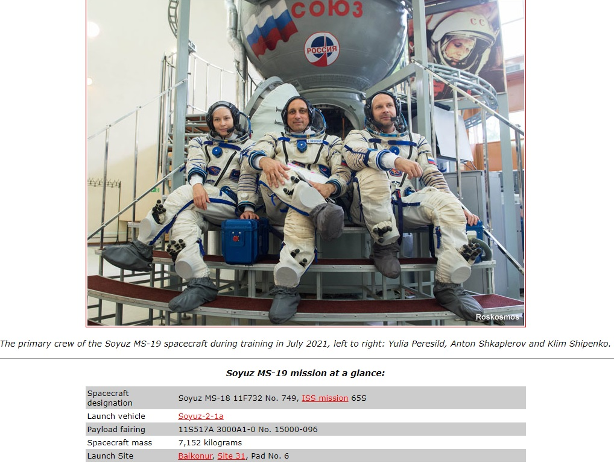

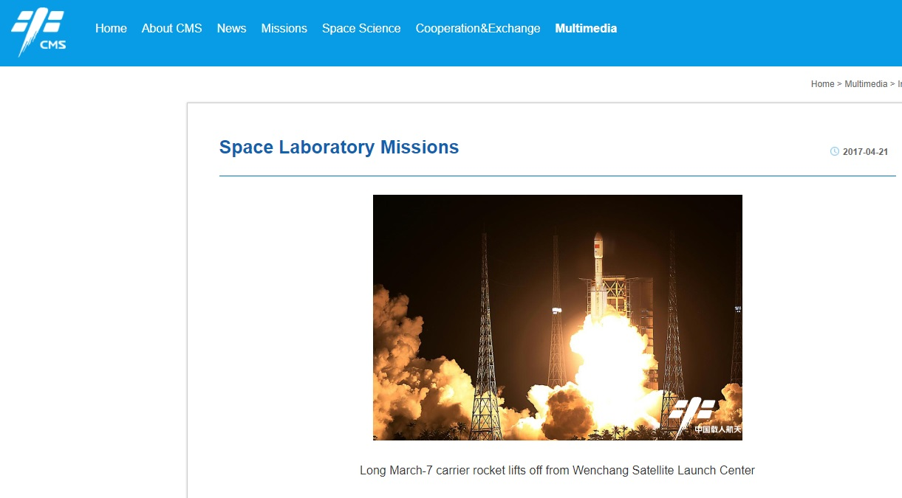
Russian Space agency
Japanese Space agency
Chinese Space agency

Slide 8
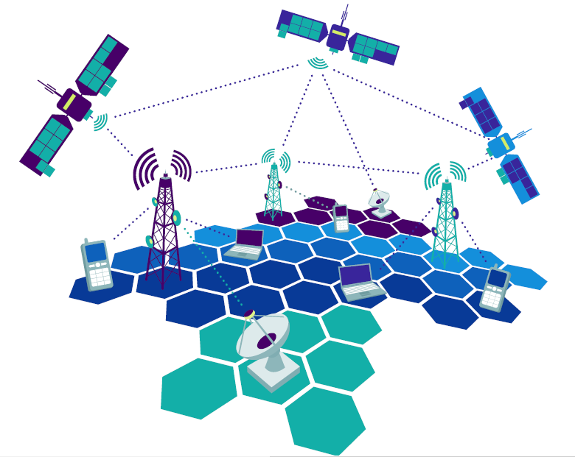
Agenda
Indian space reforms

Slide 9



Indian space reforms- main features
IN-SPACe
Indian National Space Promotion and Authorisation Centre
Opening of space sector for private investments
Offering space infrastructure to private enterprises
Knowledge sharing and mentoring for private enterprises
NSIL ANTRIX
Enable private enterprises to upgrade as end-to-end service providers

Slide 10
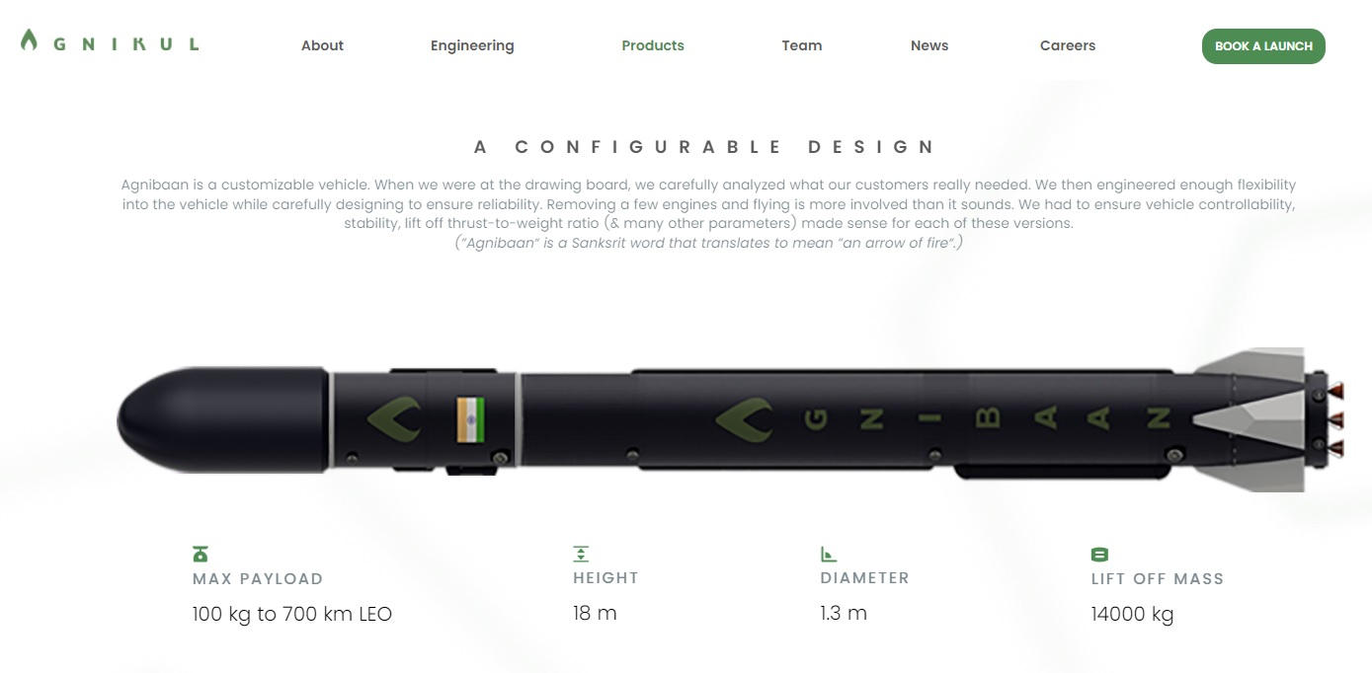
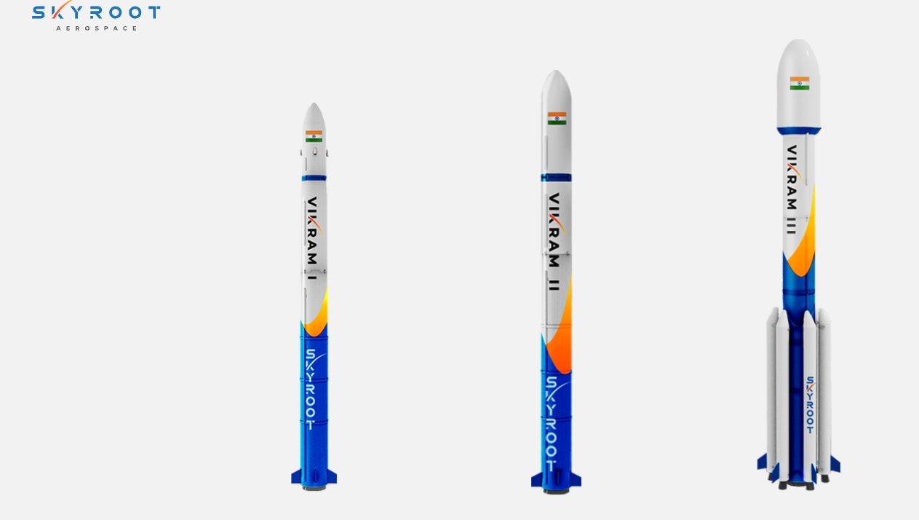

Agnikul Cosmos
Skyroot Aerospace
Dhruva Space

Slide 11
Why is Indian space sector exciting right now ?
In May 2020, Finance Minister Nirmala Sitharaman had announced the incorporation of private players in the space sector
Union Cabinet announced the formation of an autonomous agency, IN-SPACe (Indian National Space Promotion and Authorisation Centre) to help private players in space-related activities and regulate private tech innovation in the space
ISRO’s Commercial arm New Space India Limited (NSIL) is finalizing order for 5 PSLV launches to private consortium. GSLV MKIII and SSLV are also planned to be outsourced
With these policy changes and reforms, the sector is now seeing growing participation of private players
India now has around 100 active space tech start-ups. With the space sector energized, heavyweights are also showing renewed interest
With these exciting developments, the Indian space tech industry is at the verge of a space revolution

Slide 12


Opportunities in Kerala Space ecosystem

Slide 13
Kerala’s space footprint
Thumba Equatorial Rocket Launching Station (TERLS)
1962
VIKRAM SARABHAI SPACE CENTRE
ISRO Inertial Systems Unit (IISU)
Brahmos Aerospace
1960’s
1990’s
2000’s
Liquid Propulsion Systems Centre (LPSC)
Indian Institute of Space Science and Technology (IIST)
.
In the 1960s, a handful of scientists started work on India's space programme at a church in Thiruvananthapuram
Half a century later, India's space programme has grown to become one among the leading Spacefaring nations, known for its reliable, low-cost launches and attracting a growing global clientele.

Slide 14

Advantage Kerala
Organizational support
03
05
01
Qualified young talents
02
Advanced research and product development
Mentors/
consultants
04
Expert work force

Slide 15
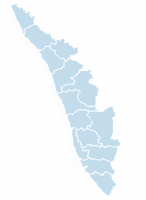
Kerala- a knowledge centre
Major educational centers in Kerala – Thiruvananthapuram, Kochi, Kozhikode
IIM Kozhikode
University of Calicut
National Institute of Technology
Government Medical College
Indian Institute of Spice Research
Kozhikode
VSSC,LPSC,IISU
IIST
IISER
RCC
NIIST
Sree Chitra Tirunal Institute for Medical Sciences & Technology
Tropical Botanical Research Centre
University of Kerala
Digital university of Kerala
Kerala Technological University
Rajiv Gandhi Biotechnology Centre
Central Marine Fisheries Research
Cochin University of Science & Technology
National University of Advanced Legal Studies
Cooperative Medical College
AMRITA Institute of Medical Sciences
Model Engineering College
Kochi
Thiruvananthapuram
 | Thiruvananthapuram | Kozhikode | Kochi
Research | VSSC,LPSC,IISU IIST IISER RCC NIIST Tropical Botanical Research Centre
Universities / Law / Management
Engineering & Technology | Kerala Technological University Rajiv Gandhi Biotechnology Centre
Medical | Govt. Medical College Sree Chitra Institute of Medical Science

Slide 16




Kerala…many successes to be proud of……
Well-trained human resource pool
Gateway to international trade
Promoting Knowledge-based industries
Best startup ecosystem
God’s own country
Kerala has a massive talent pool that is increasingly strategic to power success for the state.
Vizhinjam Seaport
Cochin Seaport
4 International Airports at Trivandrum, Cochin, Calicut and Kannur
K-rail Semi high speed rail project
Digital University
Technopark
Infopark
Cyberpark
KINFRA parks
Bio-life Science park
Kerala has around 2900 + startups working in various sectors spread across its 14 districts.
Kerala is one of the few states to have marketed its natural beauty successfully to the leisure tourism sector.
Reforms are being undertaken at all levels to unleash Kerala’s high growth potential

Slide 17






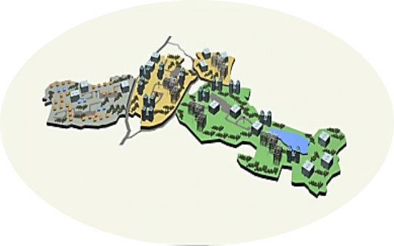

kSpace Business Models
Provide built up space on lease/rent
Collaborative development through joint ventures/SPVs
Provide a common platform to bring all the Aero(Space) industries and service providers, within Kerala, together to synergize their capabilities to take-up multidisciplinary products and services
Provide land as per requirement to Build and Operate within KERALA
Extend technical and marketing support to setup and operate businesses within Kerala Spaceparks

Slide 18
kSpace
Space park being set up with the technical support of Indian Space Research Organization (ISRO)
Platform to tap the knowledge potential of resource persons from VSSC,LPSC,IISU and IIST
Key players in the ecosystem are MSME , ANTRIX , TCS (Advanced Aerospace and Defense delivery center)
Almost 50 Medium and Small scale private enterprises currently working in Aerospace domain in and around Trivandrum
Incubator facilities and workspaces of International standards
Government support to facilitate business in the state

Slide 19
kSpace– envisages
Virtual Labs
facilities
Manufacturing
Facilities
Software Facilities
Support
Launch Support services
Electronics &
Maker Lab

Slide 20
kSpace– envisages
Simulator facility to plug in Live-Virtual space simulation
Simulation, computing, visualization facility
Plug and play interfaces for simulating and testing subsystems
High Performance Computing Centers (HPC) & visualization centers
Virtual testing systems like launch testing, vibration testing
Virtual Labs Facilities
Tools for analysis of Complex Systems
Fault Diagnosis, Alta Rica like tools
Catastrophic failure prediction tools
Modeling Tools: Model validation tool, stochastic simulation, language Alta Rica
CFD , Visualization tools and APIs
Design Software's, Logic analyzer
Software Facilities
Telemetry tracking support systems/ Services
Satellite Tracking Services : Amateur Radio satellite tracking and Custom Tracking Support
Orbit Determination Tools
Attitude Control Tools
Cargo Optimizer : payload paths, reentry paths, with pressurized and non-pressurized cabins , stress analysis (Hypersizer)
Launch Support services

Slide 21
kSpace – envisages
Thermovac Chamber
Vibration, Acoustic Test facilities
Clean Room , Satellite Integration Chamber
Compact Antenna Ranging Test facility
Storage facility
Test equipment's
Manufacturing Facilities
Access to key investment zones
Ease of Doing Business – Support through single window facilitation and clearance
Access/ Facilitation to ISRO/ Antrix
Investment friendly zones
Access to dedicated Industrial Growth Centers
Support
3D printed Satellite structure
Robotic cells for Composite manufacturing
3d Printers - plastic, Metal matrix, Carbon fiber
Additive printers , SLA printers
Laser sintering machines which can embed PCB traces, electronics in complex plastic shapes, moulds
Maker lab
Electronics & Maker Lab

Slide 22
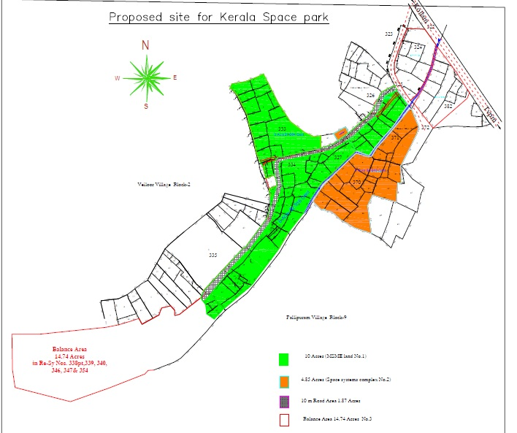
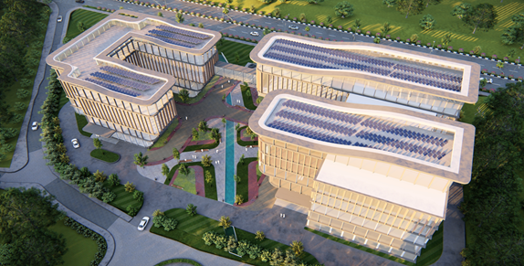
kSpace Site Plan

Slide 23
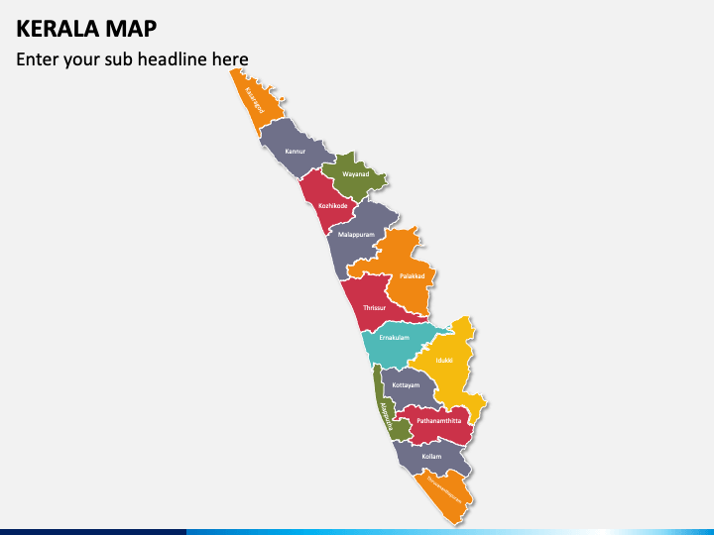


kSpace VISION
North Hub
Central Hub
Small Hubs
South
Hub
Main Hubs

Slide 24
kSpace welcomes you to God’s own country

Slide 25
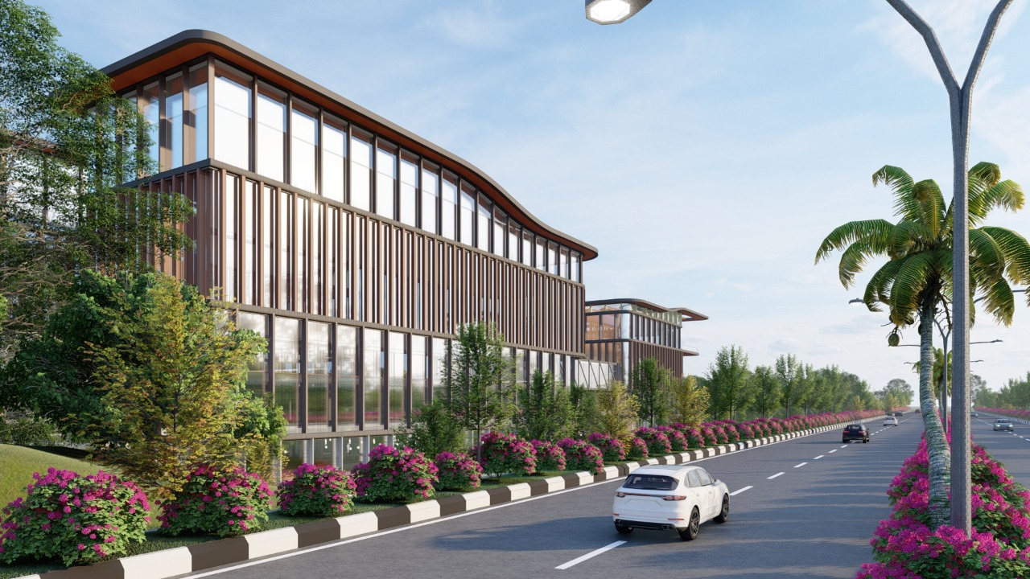
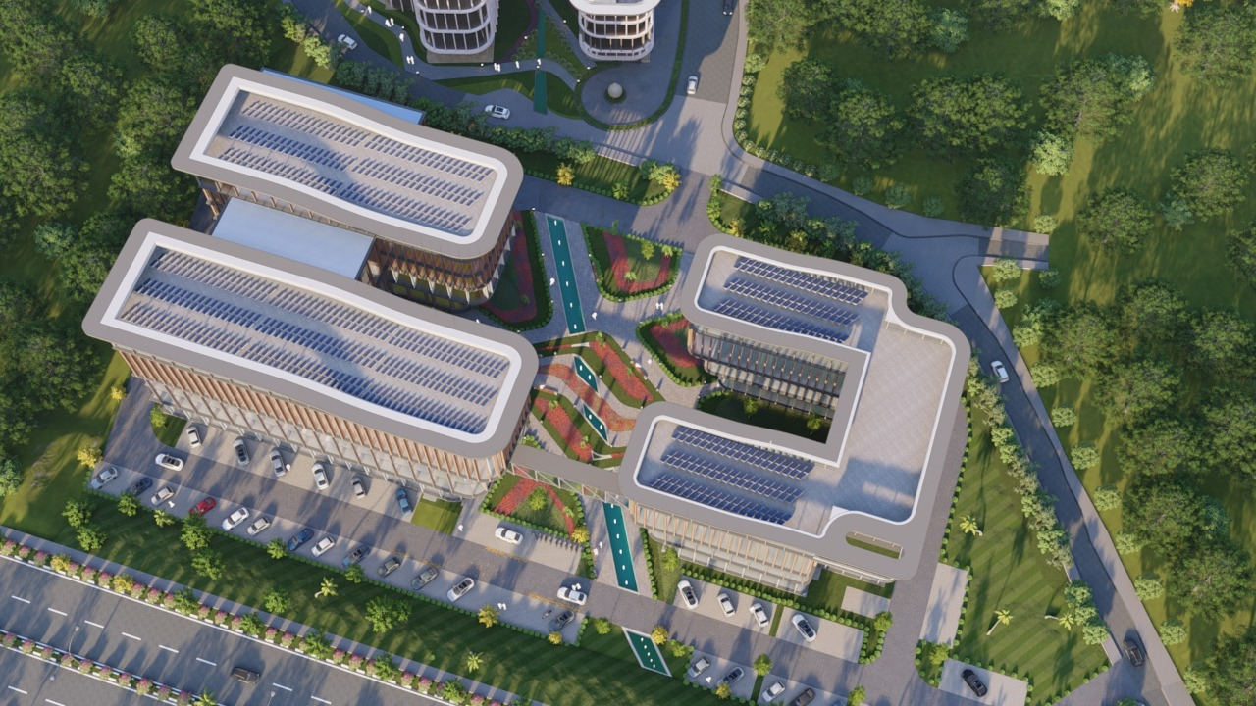
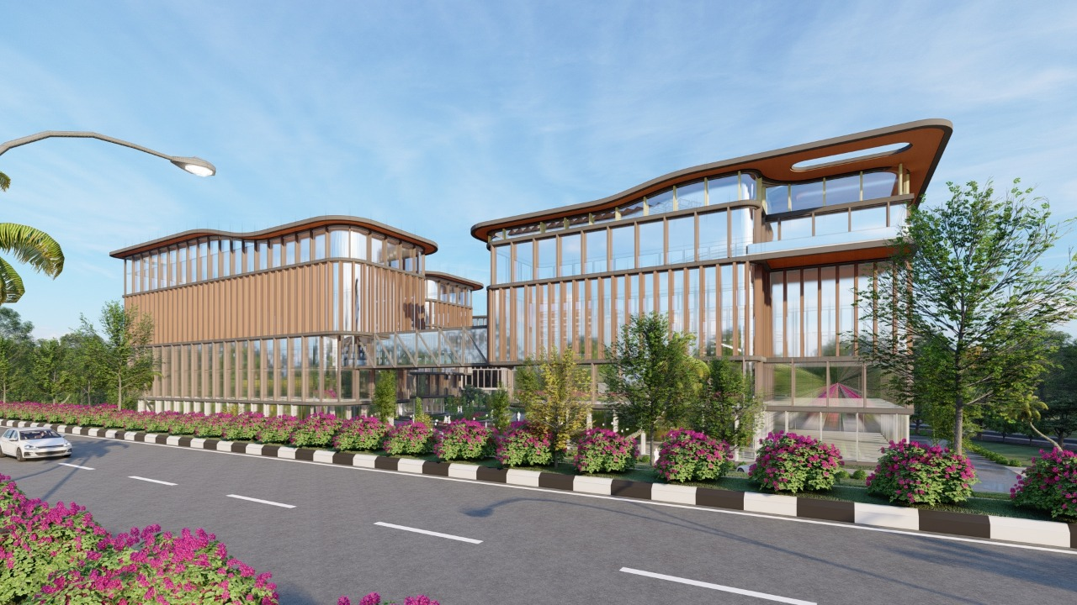
Thank you
For any queries please contact:
Dr. Santhosh Babu IAS
Managing Director, Kerala State IT Infrastructure Ltd
Government of Kerala
E-mail: md@ksitil.org| Mob: +91-9940474863
G Levin
Project Director, Kerala Spacepark (kSpace)
Government of Kerala
E-mail: pd.spacepark@ksitil.org| Mob: +91-9496050075

